Slide 1
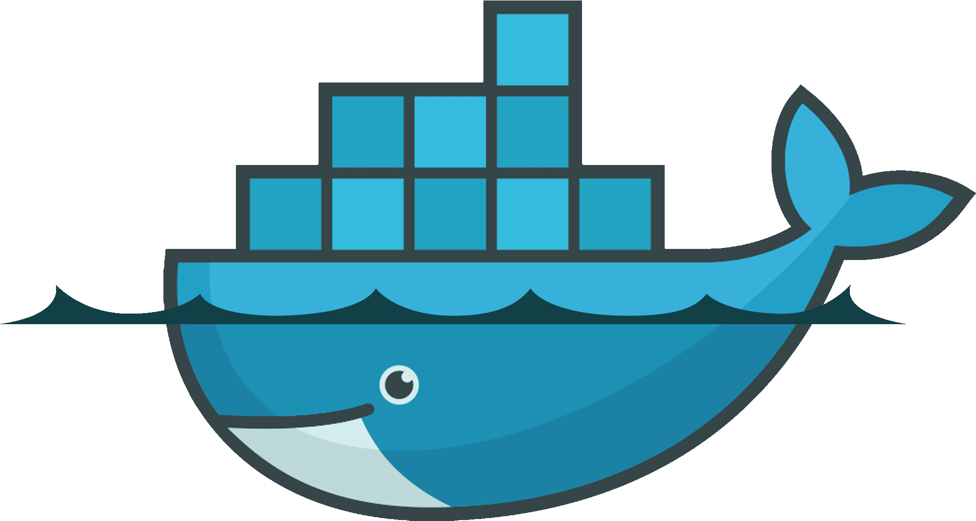

Slide 2
Docker Training
Getting Started with Docker

Slide 3
What’s Docker
It’s a lightweight, open-source and secure platform to simplify building, shipping and running apps in the cloud.
Docker is cloud and OS agnostic.
Runs natively on Windows or Linux
It can run on Azure, AWS, Google Cloud, IBM and others
Docker allows developers to have a very similar environment to Production.
Docker is not a Virtual Machine as it does not hold any Guest OS filesystem.

Slide 4
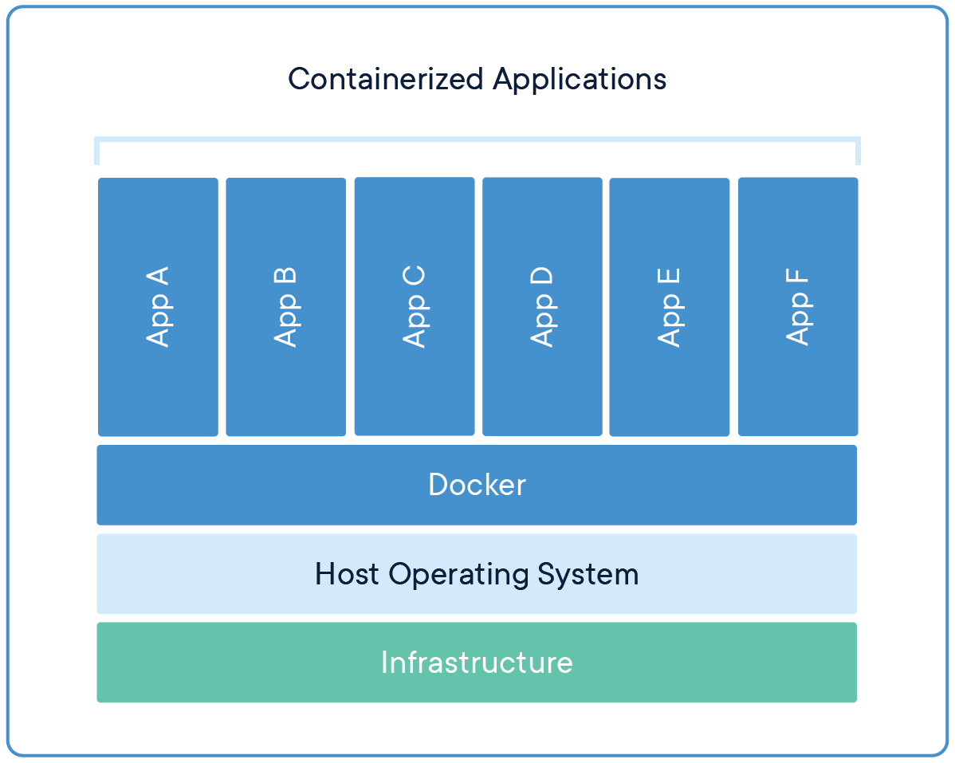
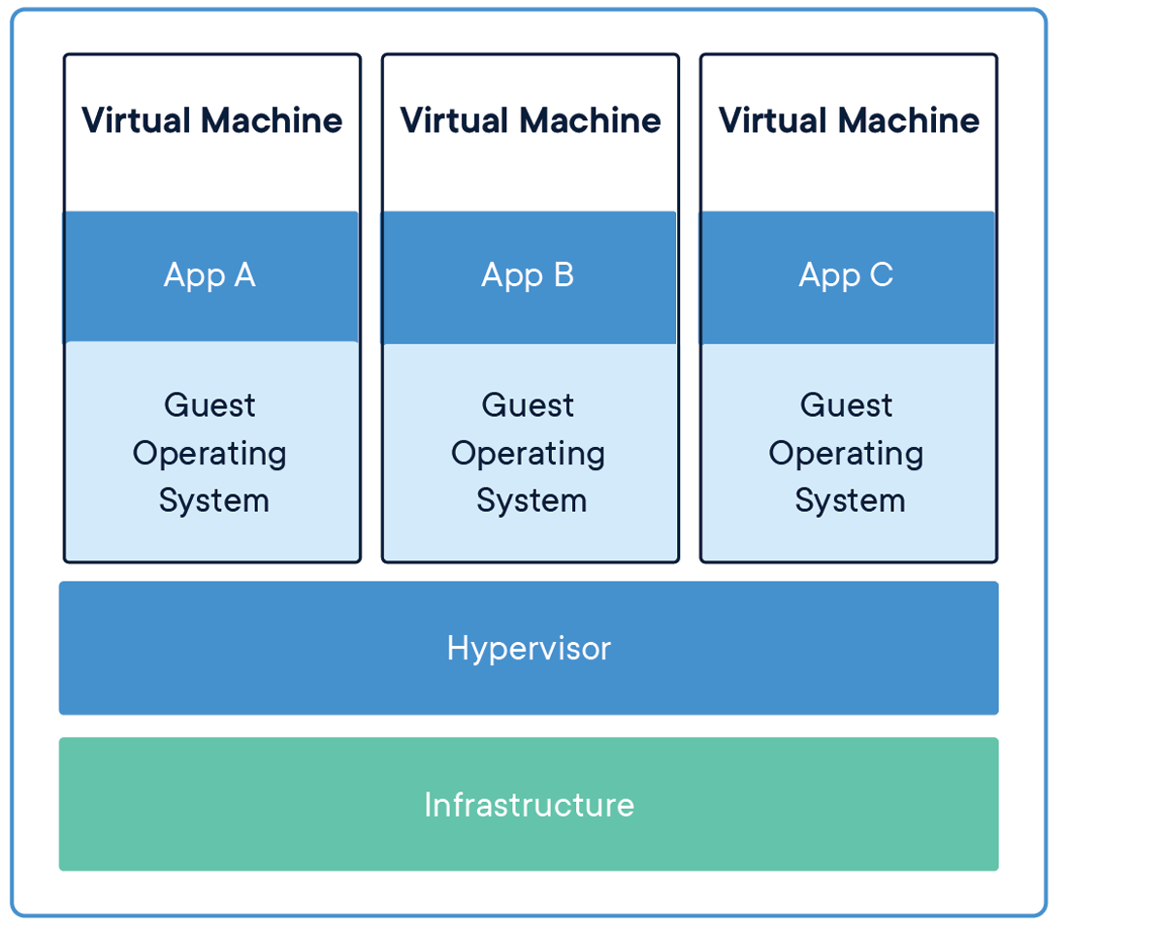
Docker vs Virtual Machine
“Lightweight: Containers share the machine’s OS system kernel and therefore do not require an OS per application, driving higher server efficiencies and reducing server and licensing costs”

Slide 5
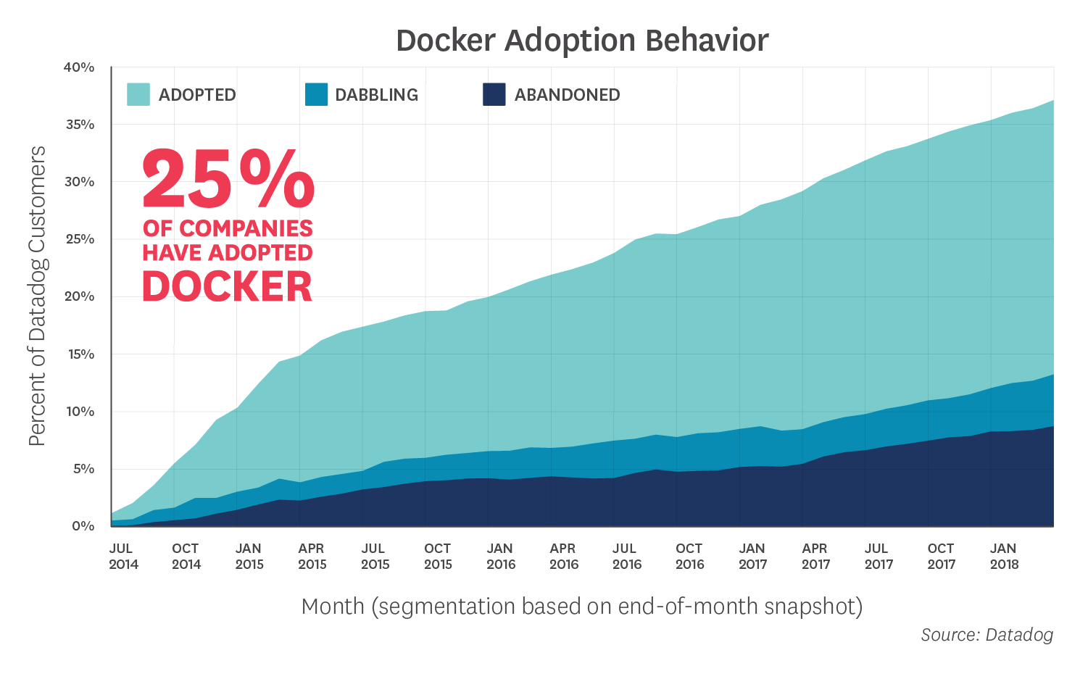





Adoption & Predictions
2019 is the year enterprises take a container-first approach and it's no surprise containers are expected to be a $2.7 billion market by 2020.
DATADOG (monitoring service for cloud-scale applications) has reported that 23.4% of its customers have adopted Docker at the beginning of 2018. (Report)
Some Adopters

Slide 6
Google Use Case
Google has all its main services running on Docker, from Gmail to YouTube to Search.
“Containerization allows our development teams to move fast, deploy software efficiently, and operate at an unprecedented scale.”
Google initially started with Borg, then evolved to Omega than Kubernetes and they’ve been managing Linux containers at scale for more than I decade.
It was Google who actually created Kubernetes and donated it to CNCF (Cloud Native Computing Foundation) and also contributed on developing container code to Linux kernel. They kept Borg (primary container orchestrator) and Omega (Borg’s sibling) as internal container orchestrators.
It’s known that Google runs billions of containers daily.

Slide 7


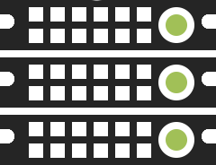
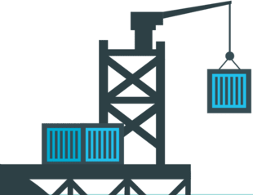
Some of the Benefits
Accelerate
Developer Onboarding
Eliminates
App Conflicts
Environment
Consistency
Speed up
Software Shipping
Docker Blog:
The Modern Software Supply Chain Runs on Docker

Slide 8
Benefits at Swapfiets
Speed up App development and release
Fast release of new Apps and versions
No downtime releases with Canary deployment and some container orchestrator
Keep up with Cloud providers evolution
Cleaner build and release pipeline
Developer machine similar to other environment
Facilitate cloud provider migration (E.g.: Reducing costs)
Enables deployment to different Cloud providers
Run automated test on temporary Apps
Facilitate adoption of Microservice architecture
Allows teams work with different tech-stack
And much more…

Slide 9

Interesting facts, right? Let’s try it than!

Slide 10
Images & Containers
Container and Images are often called as only Container, it’s because and image is just a blueprint of a container. The container itself is the runtime isolation.
Containers are secure as they are isolated from external access by default, if access to a container is required (E.g.: WebApp on port 80) it must be configured and exposed to the external world.
Image
An image contains all the files needed to run an isolated application as a container. Imagine an Image as an application package.
It’s a read-only template composed of layered filesystems.
Container
It’s a running instance of an Image, it’s a running application with its own runtime, filesystem (R/W) and network.

Slide 11
Volumes & Network
Volumes
Volumes are mechanisms for persisting data generated by and used by containers.
They are easy to back up or migrate and can be managed by Docker CLI or Kubernetes/Swarm dashboard
Works both on Linux or Windows
Volumes drivers allows us to store data on remote hosts or cloud providers
Networks
Networks are used to enable cross container communication in the same Docker host or in different hosts, it also allows container isolation.
It allows container to appear as a physical device on a private network.
There are five default network types
Bridge: Default network driver, usually used for standalone containers and we can create custom bridge networks.
Host: For standalone containers, remove network isolation between the container and the Docker host, and use the host’s networking directly.
Overlay: Enables container communication across multiples Docker hosts. E.g.: Containers in AWS and in Azure could communicate with each other.
Macvlan: Allows assigning MAC address to containers, provisioning them as a physical device on a network.
None: Disables all networking.

Slide 12
Docker Tools
Docker Toolbox is a docker tool to run on old version of Windows or Mac (Windows 7/8 or Mac)
Provides images and container tools
Virtual machine (for Windows/Mac)
Works on Windows, Mac, and Linux
Docker Desktop is a toolbox which provider images and container tools. However we’ll need to have HyperV or Virtual Box installed.
Tools
Docker Client (CLI)
Docker Compose
Docker Machine (Used for managing Docker hosts)
Docker Kitematic (UI tool for managing images and containers)
VirtualBox (only when using Docker Toolbox – Docker VM)

Slide 13
Docker CLI
Docker Client (CLI) is the docker tool to manage images, containers, volumes and networks, manage deployments and a few other things.
For more details on Docker CLI, see Docker Cheat-Sheet or Docker CLI.
Ok, so let’s try Docker CLI now!
Docker.md
README.md (Samples)

Slide 14
Docker-Compose
Compose is a tool for defining and running multi-container Docker applications. It’s based in a declarative way where we express the images to download and the containers, volumes and networks to provision in a Docker host. We also can set ENVIRONMENT variables or ARGUMENTS that our containers will have access to.
IMPORTANT: Do not set any secrets on Environment variables or Arguments as they can be found in a container inspection, for examples running docker history command in an image.
Nice, time to play with Docker-Compose!
For more information, visit Docker-Compose page.

Slide 15
Dockerfile
Dockerfile is a text document which contains all the commands for creating of a Docker Image.
It can simple be a file called Dockerfile or a file with .Dockerfile extension, E.g.: MyWebApi.Dockerfile.
For more information, visit Dockerfile page.

Slide 16
Hands-On
Some Sample Apps on GitHub
https://github.com/higtrollers/Swapfiets.Docker
Creating Images and spinning Containers
docker build
docker run
Managing Images and Containers
docker image ls
docker container ls
docker rmi {image-id}
docker rm {container-id}
Managing Volumes and Networks
docker image ls

Slide 17
References
About
What’s a Container
Borg, Omega and Kubernetes Lessons Learned
Training
Pluralsight Docker for Developer
Pluralsight Docker Deep Dive
Reports & Articles
The Forrest New Wave Q4 2018 Report
The Year Container Platforms Are Run At Scale Within the Enterprises

Slide 18
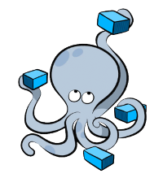
Questions?

